Slide 1

Computer Assembling
Alperen Yüksel 22197484
Arslan Çağrı İnan 21995529
Ata Kaan Can Olcay 21996168

Slide 2
Explanation
This project involved a comprehensive exploration of computer hardware components and their functionalities. While budgetary constraints were not a factor, our team opted to select the most advanced models available for each component. Throughout the assembly process, occasional compatibility issues arose between certain hardware parts. These challenges were effectively addressed by substituting components from different manufacturers. Despite these minor hurdles, the project proved to be a thoroughly enjoyable and rewarding experience for all three participants. The successful completion of this project significantly enhanced our collective understanding of computer assembly best practices and the importance of component compatibility.

Slide 3
Case Equipments
In this project, we commenced by assembling the primary case components, prioritizing essential elements over optional equipment.

Slide 4
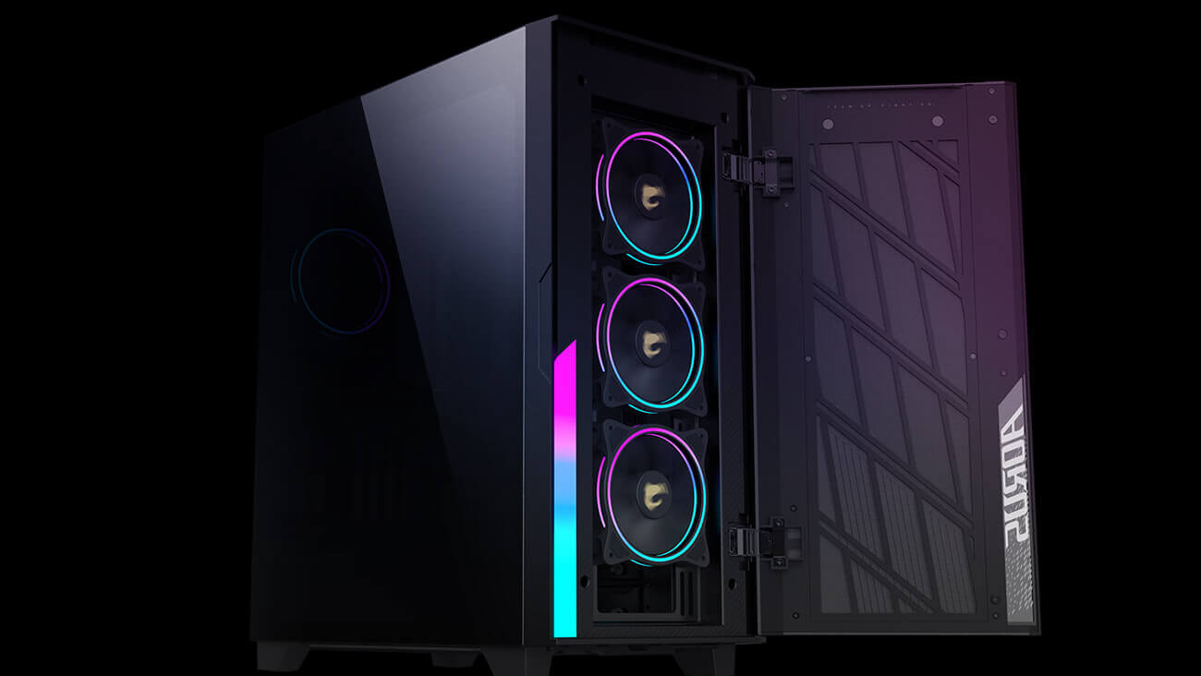
1- Case
The computer case protects the computer components to be placed inside against physical impacts that may come from outside, insulates them electrically, and expels the hot air inside with its fans.

Slide 5
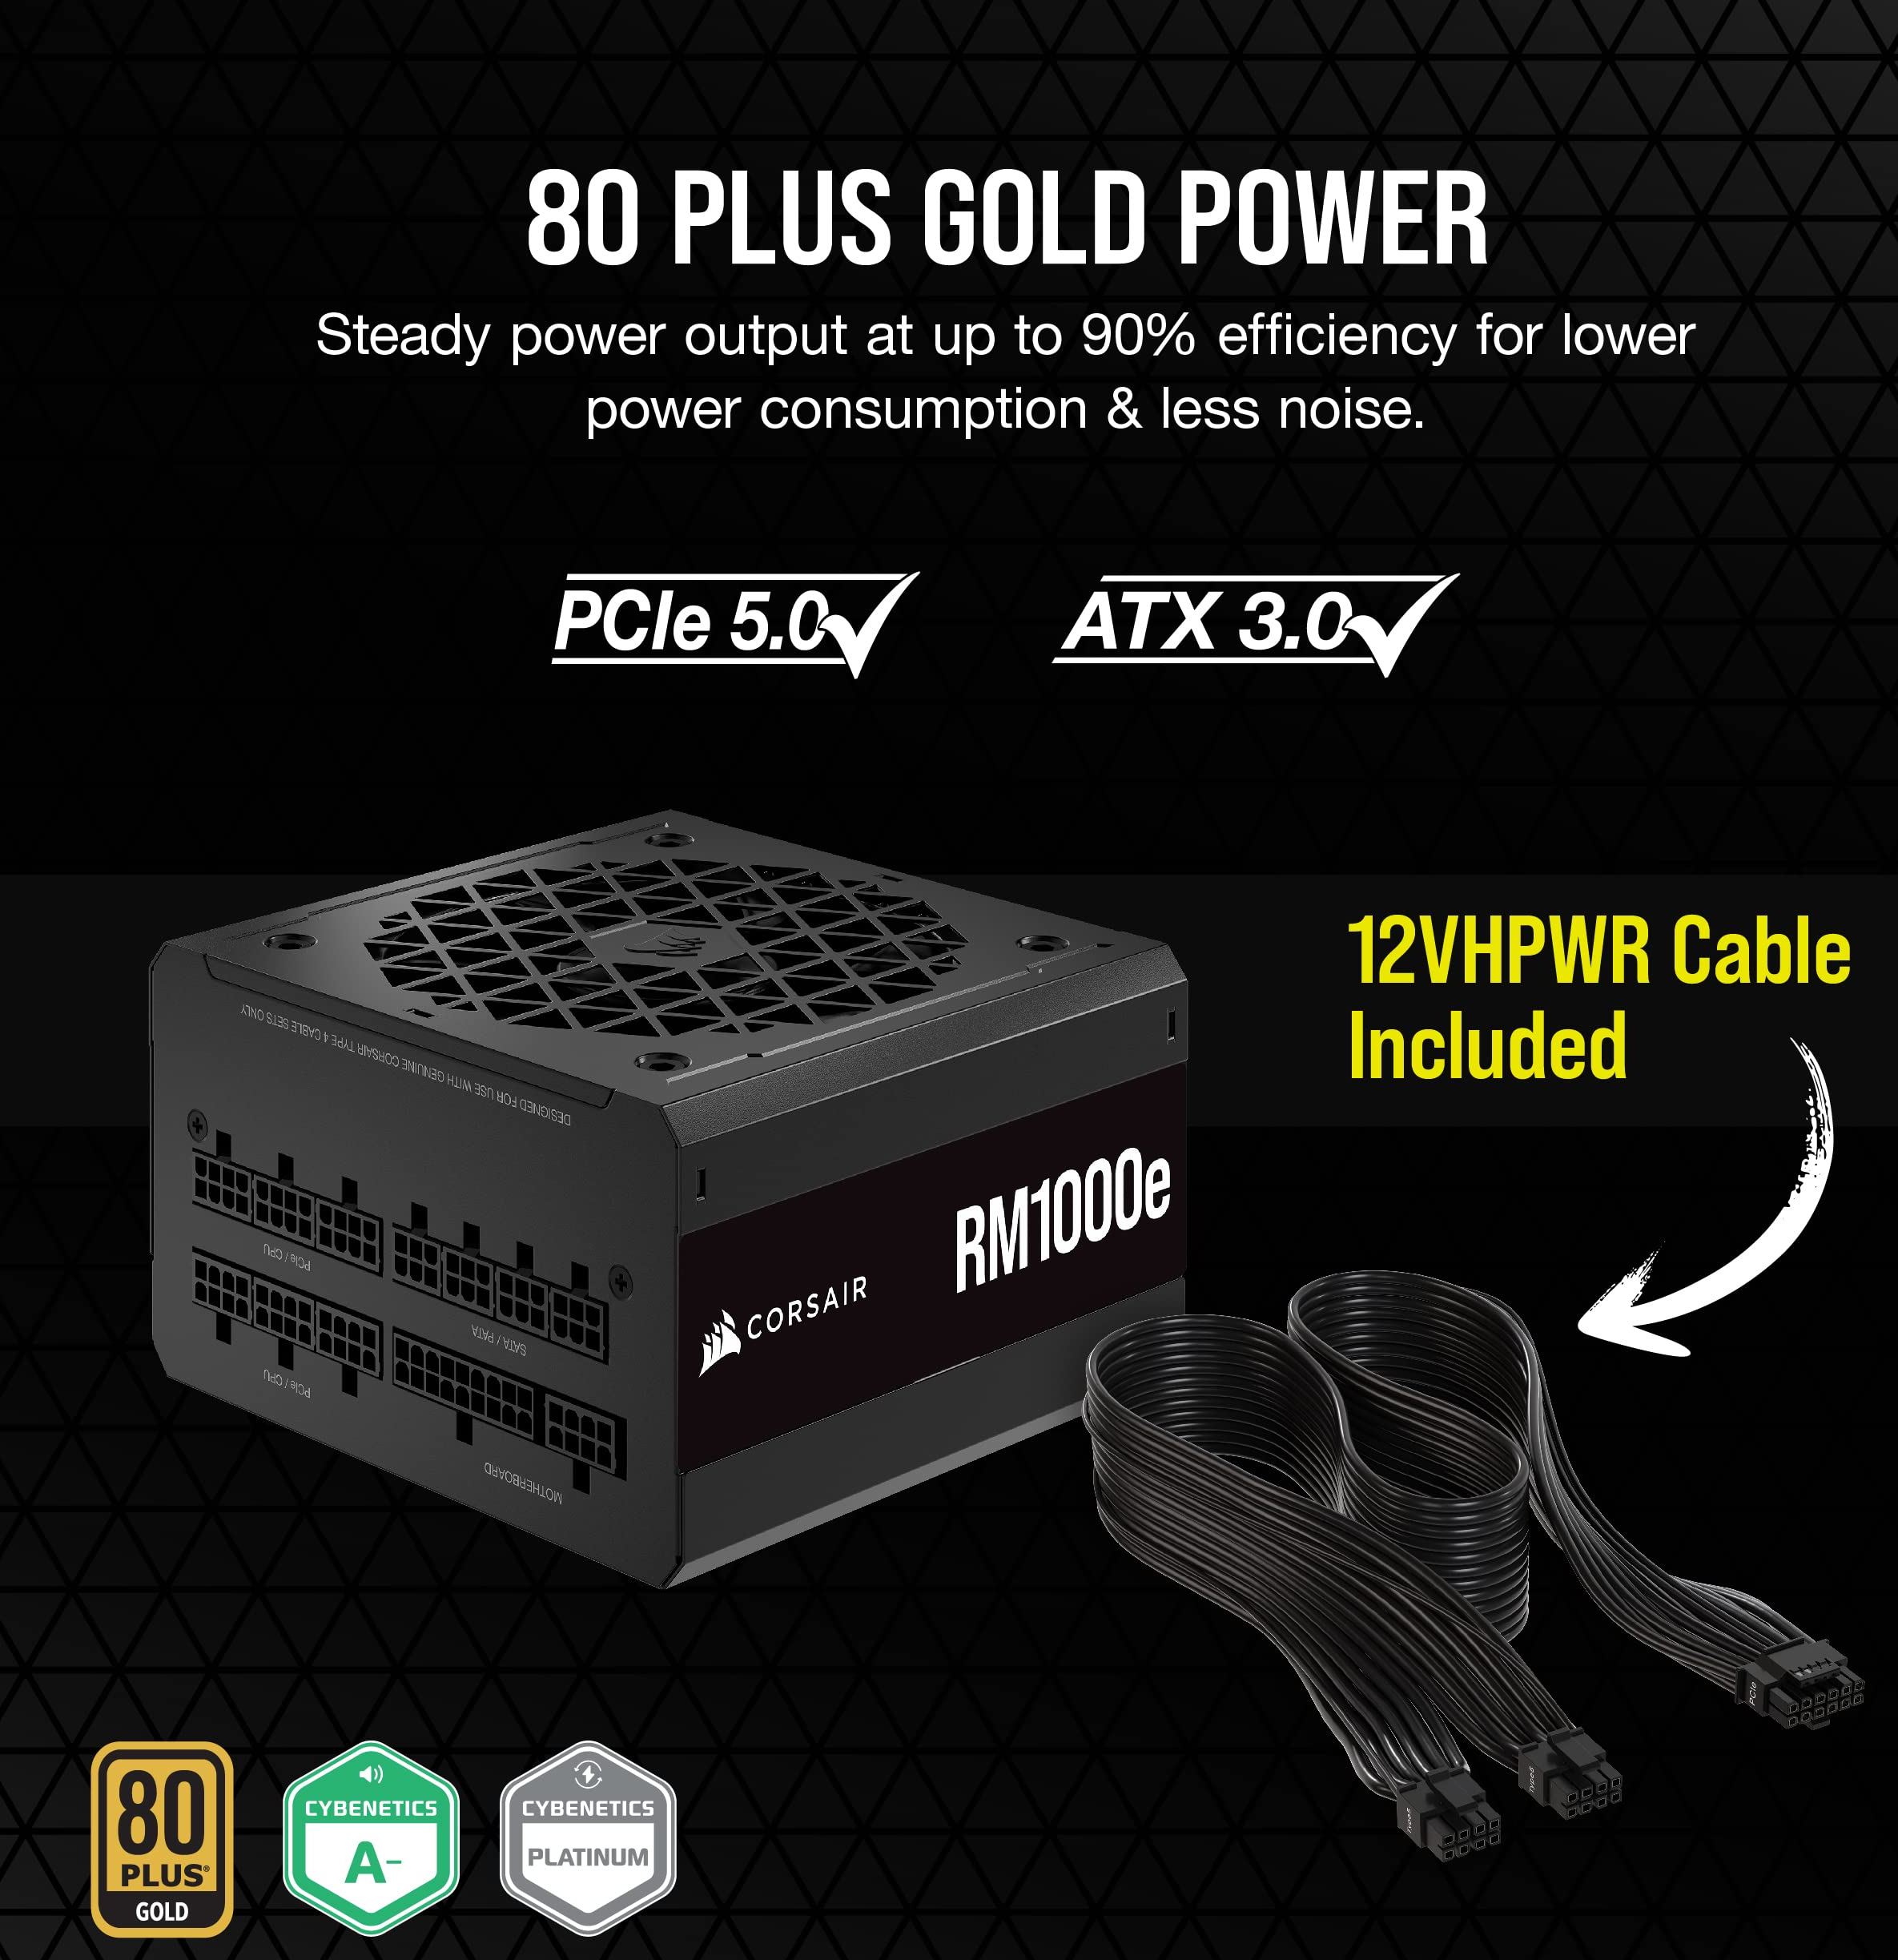
2-Power Box
A power box is a hardware component that enables electrical energy to be used in different types and voltages.

Slide 6
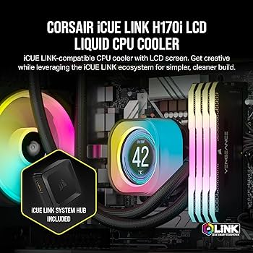
3-Coolers (using liquid or using air)
Liquid cooling is a system used to prevent electronic devices from overheating. Any product that runs on electrical energy gets hot.

Slide 7
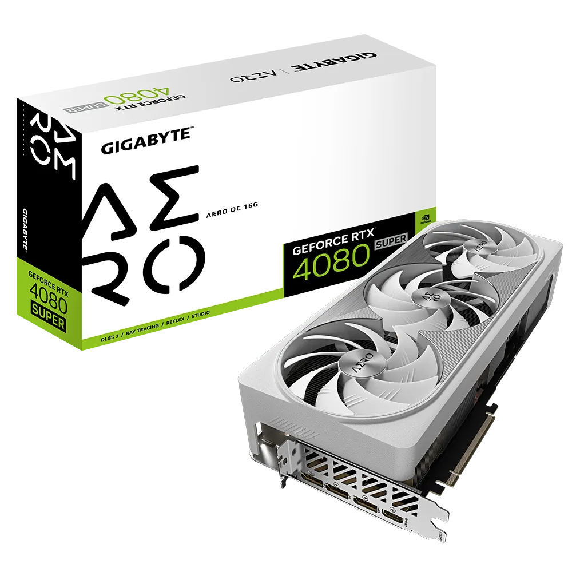
4-Video Card
A video card is the material that acts between the monitor and the processor in creating shapes such as text, pictures, videos and graphics on the computer screen.

Slide 8
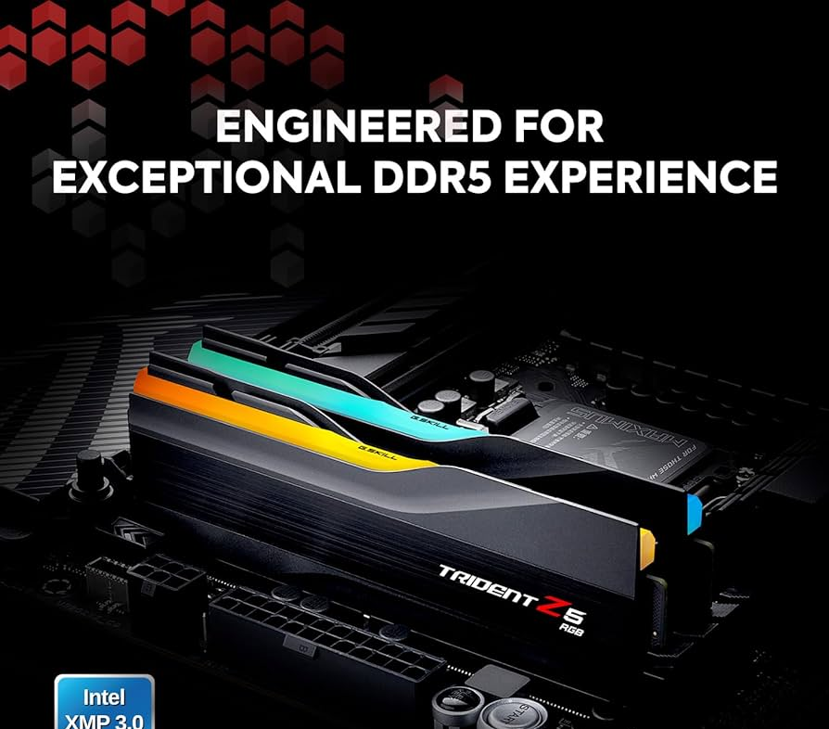
5-Ram(Random Access Memory)
:RAM (Random Access Memory) provides fast access and temporary data storage for data on computers. RAM is located between the processor and fixed data storage such as HDD/SSD. When a computer turns on, the processor requests data (such as the operating system) from the HDD/SSD and loads it into RAM.

Slide 9
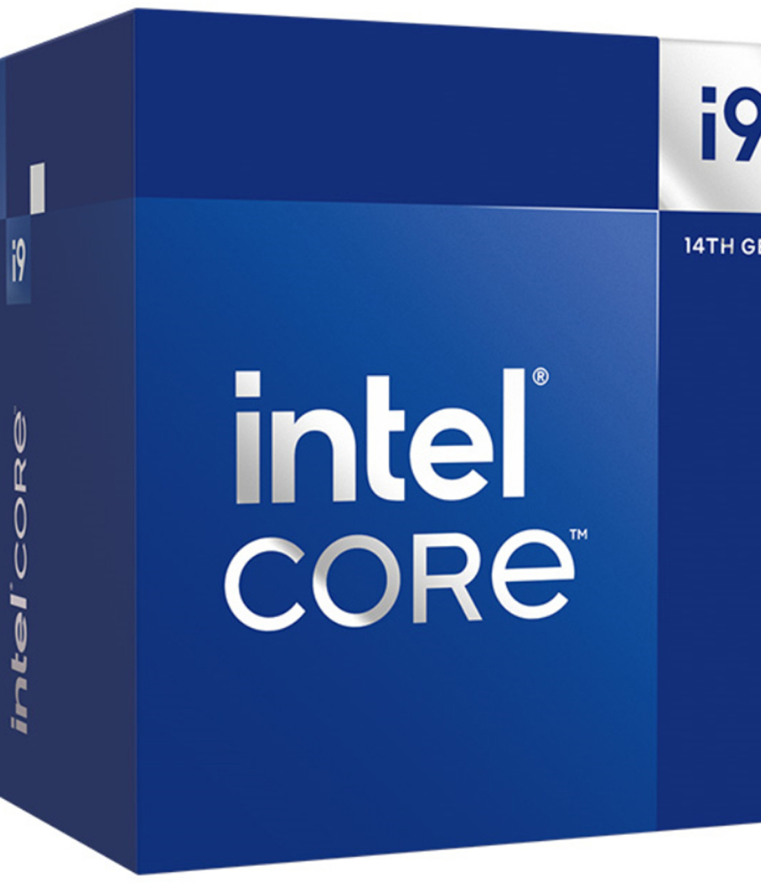
6-CPU
The central processing unit (CPU) is the hardware component that is the basic computing unit in the server. Servers and other smart devices convert data into digital signals and perform mathematical operations on them. The CPU is the primary component that processes signals and provides computing.

Slide 10
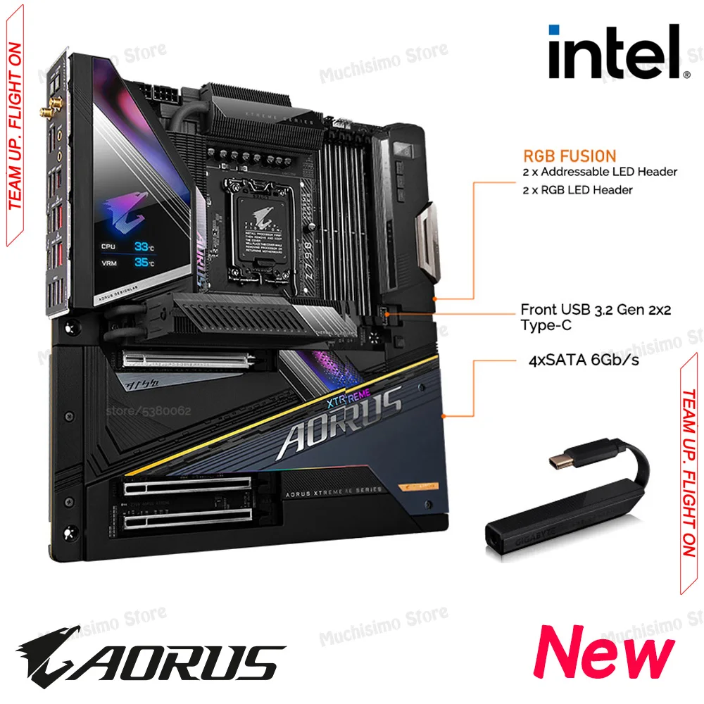
7-Motherboard
The computer motherboard connects the hardware required in a digital system. It provides power to the hardware by providing data flow between them. It also ensures that each part works efficiently.

Slide 11
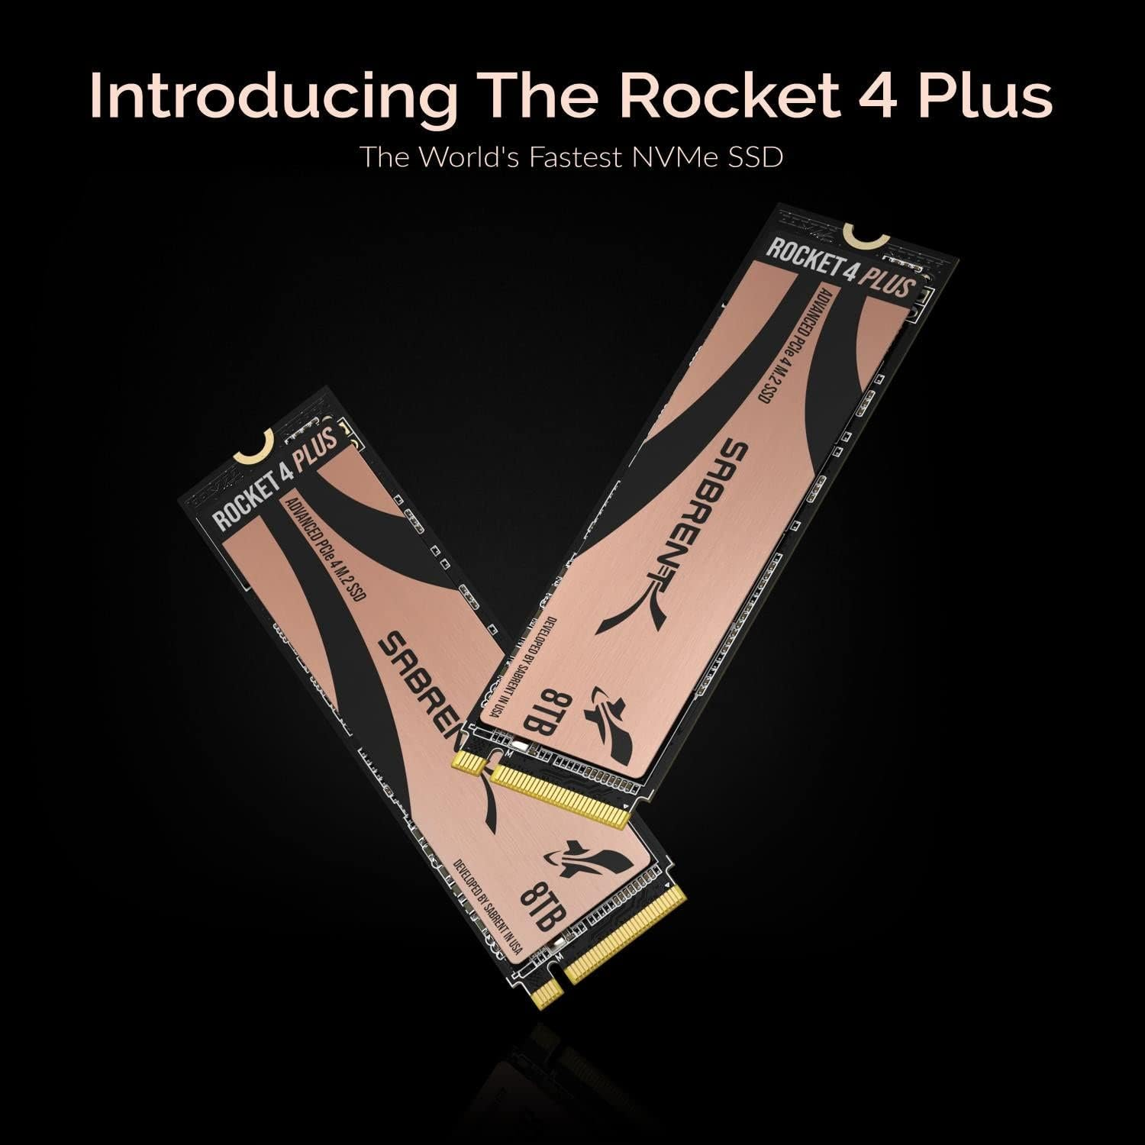

8-SSD
SSDs are faster, compact and secure data storage devices that replace hard disks. SSD uses entirely memory chips instead of the mechanical platters driven by a motor in classic hard drives.

Slide 12
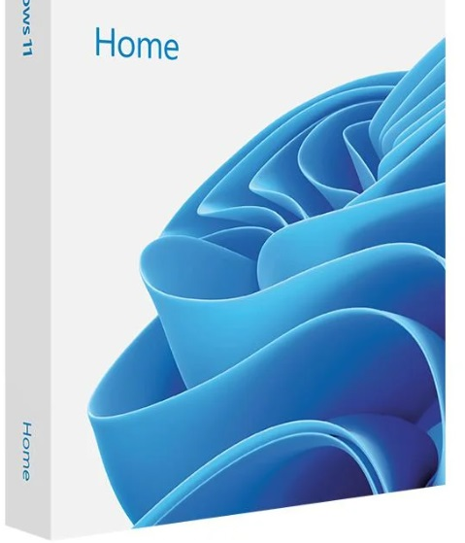
9- OS (Operating System)
Operating systems play an active role in managing the hardware resources on the computer. In addition, software that provides services for various application software can be used more effectively thanks to the operating system.

Slide 13
Optional Equipments
After gathering the basic requirements of the case and its interior, we also wanted to add a few features that can enhance user experience and provide maximum efficiency in the easiest way possible.

Slide 14
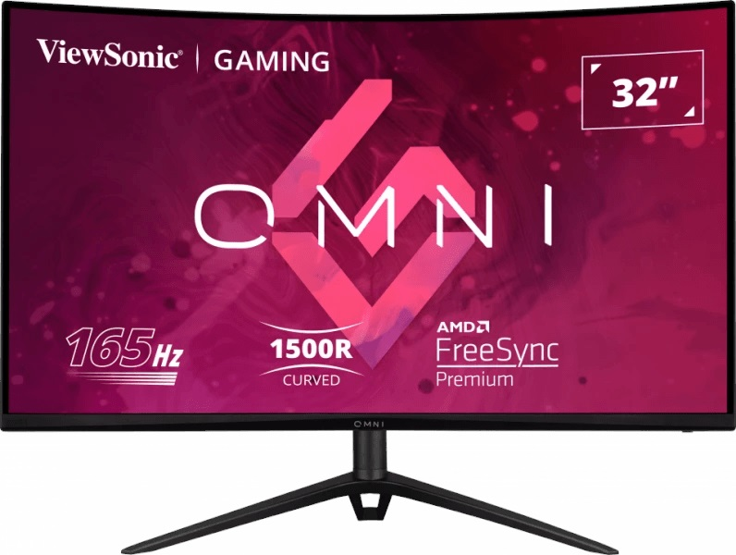
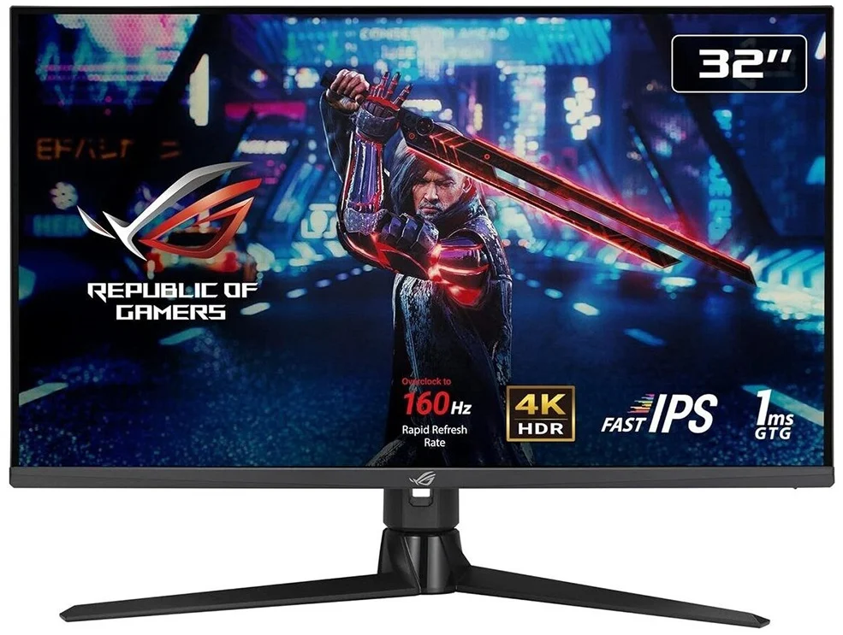
10- Monitors
Computer monitors convert signals from the device's microprocessor into images. This device; It is used to visually display photos, documents, videos, movies or any other content.
We use 2 monitors together.

Slide 15
Cost
Case 6.427 Turkish Liras
Power 4,493 Turkish Liras
Cooler 11.912 Turkish Liras
Video Card 53.000 Turkish Liras
RAM 17.121 Turkish Liras
CPU 22.369 Turkish Liras
Motherboard 23.671 Turkish Liras
SSD 38,503 Turkish Liras
OS 4.100 Turkish Liras
Monitors 42,000 Turkish Liras 6.600 Turkish Liras
Total 230.196 Turkish Liras

Slide 16
Thanks for watching and listening us.

